Slide 1

Machine Learning

Slide 2
AGENDA
What is Machine Learning?
Why Machine Learning Matters
Types of Machine Learning
Supervised vs Unsupervised vs Reinforcement Learning
Machine Learning vs Deep Learning

Slide 3
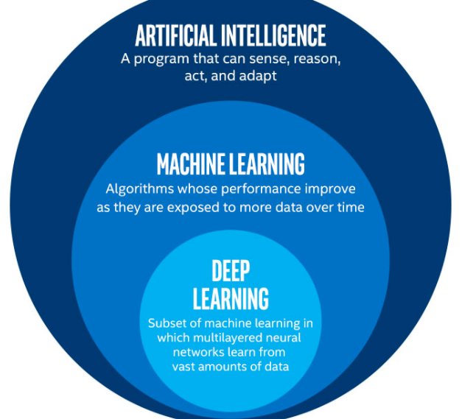
Machine Learning
Definition: Machine Learning is a subset of artificial intelligence (AI) that allows systems to learn from data and improve over time without being explicitly programmed.
Goal: To develop algorithms that can identify patterns in data and make predictions or decisions based on that data.

Slide 4
Why ML Matters?

Slide 5

Why Machine Learning Matters?
Automation: ML enables automation of tasks that require human intervention.
Improved Accuracy: ML models can often outperform human decision-making in certain domains.
Wide Applications: ML is used in various industries such as healthcare, finance, entertainment, e-commerce, and more.

Slide 6
Types of Machine Learning

Slide 7
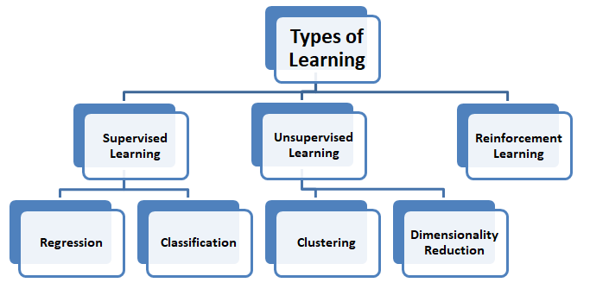

Slide 8
1. Supervised Learning
Description: The model is trained on labeled data. It learns the relationship between the input features and the output labels.
Example: Predicting house prices based on features like size, location, and condition.
Algorithms: Linear Regression, Decision Trees, SVM, etc.
2. Unsupervised Learning
Description: The model is trained on unlabeled data and tries to find patterns or structures within the data.
Example: Customer segmentation based on purchase behavior.
Algorithms: K-Means Clustering, Hierarchical Clustering, PCA, etc.
3. Semi-supervised Learning
Description: A combination of supervised and unsupervised learning. The model uses a small amount of labeled data and a large amount of unlabeled data.
Example: Labeling a dataset with a few manual annotations and using unlabeled data to improve the model.
Algorithms: Self-training, co-training.
4. Reinforcement Learning
Description: The model learns by interacting with an environment and receiving feedback through rewards or penalties.
Example: Training an agent to play a game like Chess or Go.
Algorithms: Q-learning, Deep Q-Networks (DQN), Policy Gradient methods.

Slide 9
ML vs DL

Slide 10
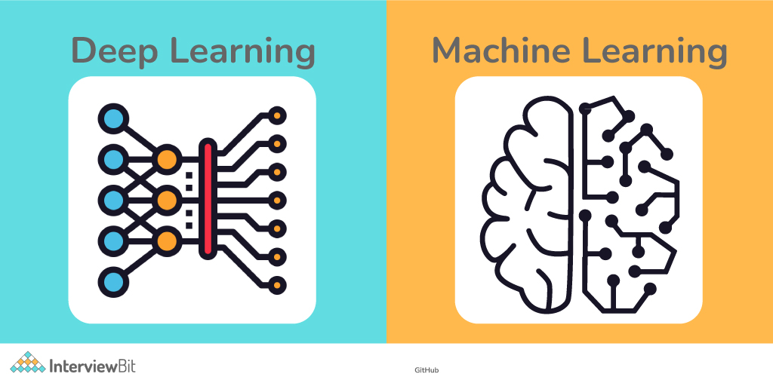

Slide 11
Questions ?

